Slide 1
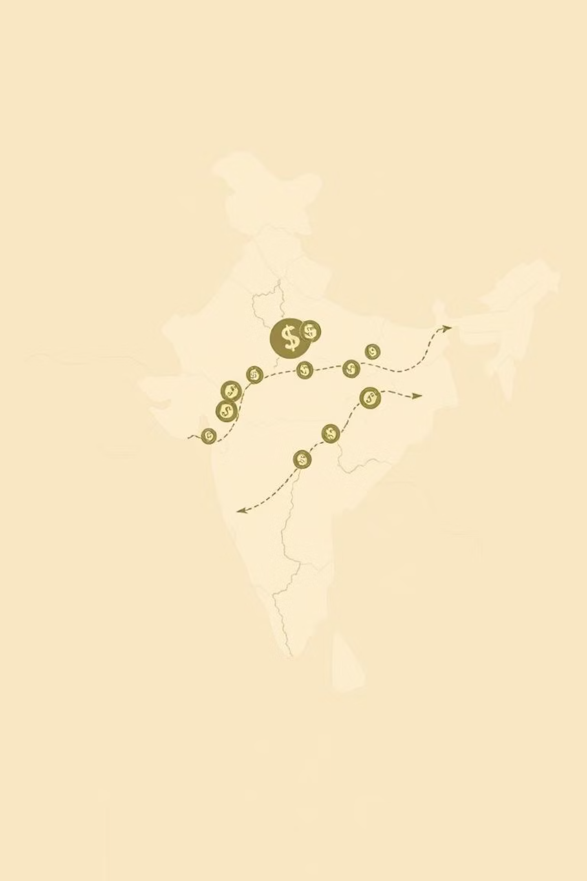
IndiCoin: India’s Sustainable Crypto Reserve Token
InnovAct 2025 Hackathon
Track: AI/ML Blockchain
Team Name: IndiCoin
Yukti ID: IR2025-995940
Members:
Aaryan Shrivastav 23BCE0927
Samagra Srivastava 23BCE0874
Janaki Pillai Raghav 23BCE0806
Uzair Shaikh 23BCE0870
Saanvi Mishra 23BDS0013

Slide 2
The Challenge
INR's Crypto Conundrum
The Indian Rupee (INR) struggles for stable representation in the global crypto ecosystem, leading to:
Volatility Exposure
Limited Utility
Erosion of Trust
INR-pegged tokens often lack robust, transparent reserves, exposing users to hidden risks and instability.
Lack of a credible, stable INR crypto hinders its adoption for cross-border transactions and DeFi.
Past failures of other stablecoins underscore the need for verifiable, dynamic reserve management.
"India's digital economy needs a sovereign digital asset that is both stable and transparent."

Slide 3




Our Solution
IndiCoin: Sustainable & Secure
IndiCoin is a blockchain-based, INR-backed crypto token designed for stability, transparency, and social good.
Hybrid Reserve
AI/ML Anomaly Detection
Backed by a diversified reserve of INR, BTC, and ETH for enhanced stability and liquidity.
Real-time monitoring of reserve fluctuations and suspicious activities for proactive risk management.
Proof-of-Reserve
Green Fund Contribution
Publicly accessible dashboard showcasing real-time reserve composition and health.
A 1% transaction fee is automatically allocated to support sustainable initiatives in India.

Slide 4
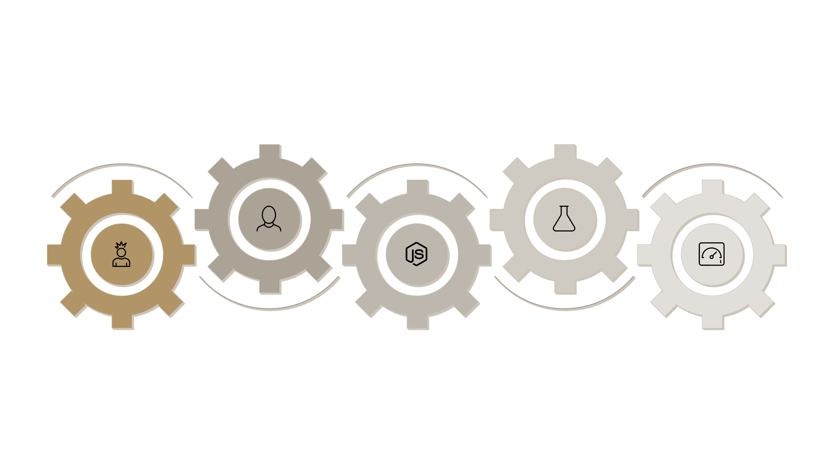
Technical Approach
Architecture & Workflow
Smart Contract
ML Analytics
Solidity on Polygon Testnet mints/burns
Python performs anomaly detection
User Frontend
Backend Node
Reserve Dashboard
React.js + Web3.js initiates transactions
Node.js fetches Coin Gecko real-time prices
Proof-of-Reserve updates in real time
Frontend: React.js, Web3.js for seamless user interaction.
Smart Contract: Solidity on Polygon Testnet for efficiency and low fees.
Backend: Node.js, integrating with CoinGecko API for market data.
Analytics: Python for AI/ML models (e.g., scikit-learn, TensorFlow) to detect anomalies.

Slide 5
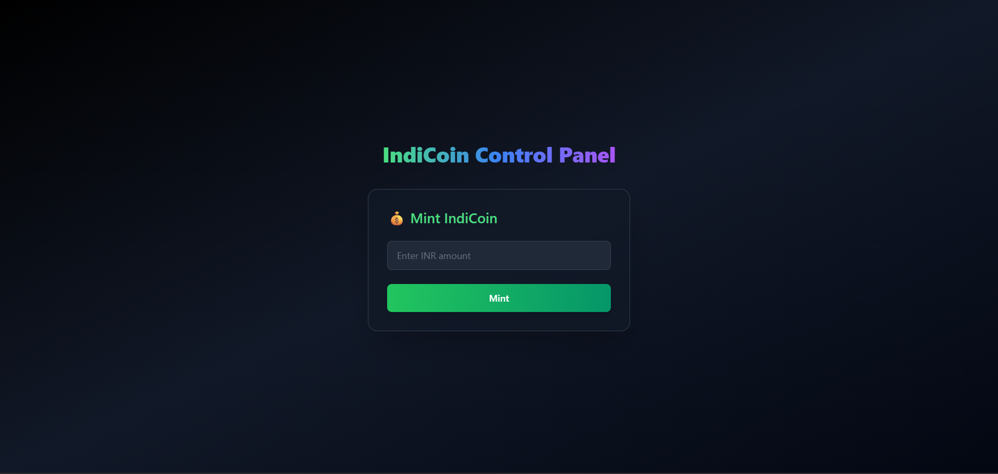
Demo / Prototype
Live in Action

Slide 6




Impact & Use Cases
Real-World Applications
IndiCoin benefits diverse stakeholders and offers versatile applications:
Indian Diaspora
Cross-Border Trade
Low-cost, fast remittances to India, avoiding traditional banking fees and delays.
Facilitates seamless international transactions for businesses dealing with INR.
DeFi Ecosystem
Green Investments
Provides a reliable INR-pegged asset for lending, borrowing, and staking on DeFi platforms.
Directly supports environmental projects, aligning finance with sustainable development goals.

Slide 7
Challenges & Solutions
Overcoming Hurdles
AI/ML Integration
Solution
Integrating complex AI models for real-time anomaly detection with blockchain data.
Developed a dedicated Python backend with optimized APIs for efficient data processing and model inference.
Reserve Simulation
Solution
Accurately simulating reserve fluctuations and real-time BTC/ETH price impact for stability.
Utilized historical market data and robust financial modeling techniques to build a dynamic simulation engine.
Hackathon Scope
Solution
Ensuring core functionalities were achievable within the hackathon timeframe.
Focused on a minimum viable product (MVP) demonstrating key features, with clear future development roadmap.

Slide 8





Future Scope
Scaling IndiCoin's Impact
RBI Integration & Compliance
Working with regulators for official recognition and integration with India's financial infrastructure.
Expanded Green Partnerships
Collaborating with more NGOs and environmental projects to maximize sustainable impact.
Cross-Chain Interoperability
Enabling IndiCoin to be used seamlessly across multiple blockchain networks.
Advanced AI/ML Models
Implementing predictive analytics for reserve optimization and early warning systems.

Slide 9

Conclusion
Trust, Transparency, Scalability
Trust: IndiCoin provides a stable, verifiable INR-backed digital asset, fostering confidence in crypto.
Transparency: Our AI-powered reserve management and public dashboard ensure unprecedented clarity.
Scalability: Built on Polygon, IndiCoin is ready for mass adoption in India's rapidly growing digital economy.
"IndiCoin is not just a token; it's a bridge to India's sustainable financial future."

Slide 10
Acknowledgements
Thank You
InnovAct 2025 Organisers: For providing this incredible platform.
Judges: For your valuable time and insightful feedback.
Mentors for invaluable guidance and support.
Our Fellow Hackers: For the inspiring atmosphere and collaborative spirit.

